Slide 1
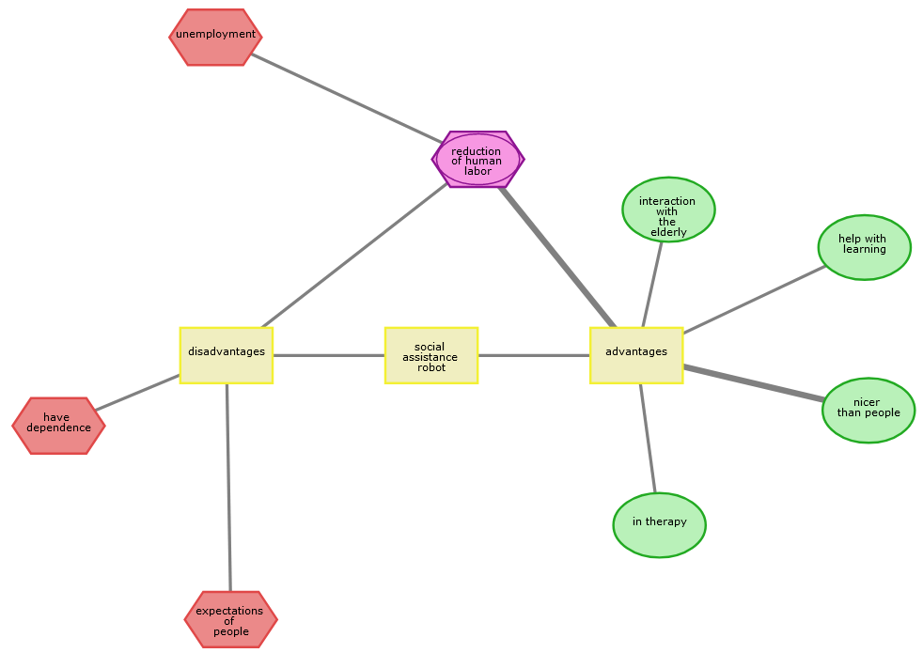
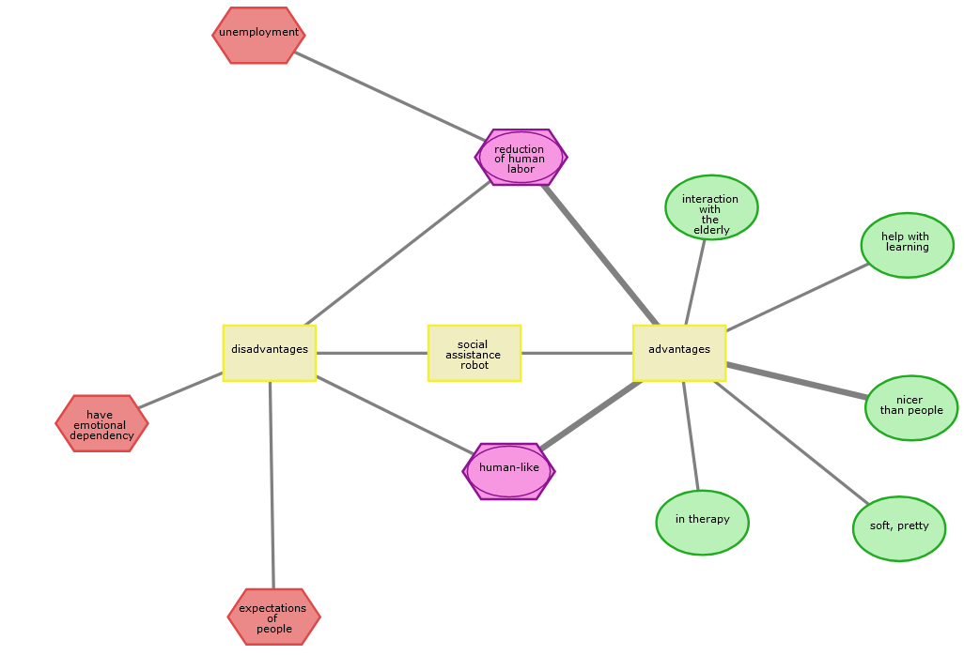

Socially Assistive Robot
Intervention
Random assignment
Add information on soft robot
Adjust drawn CAM
Draw CAM
Search and Rescue Robot
Super grober Draft, müsste man ggf. anpassen, korrekte CAMs, Pfeile, Hervorhebungen, Größer Herv. etc.

